Slide 1


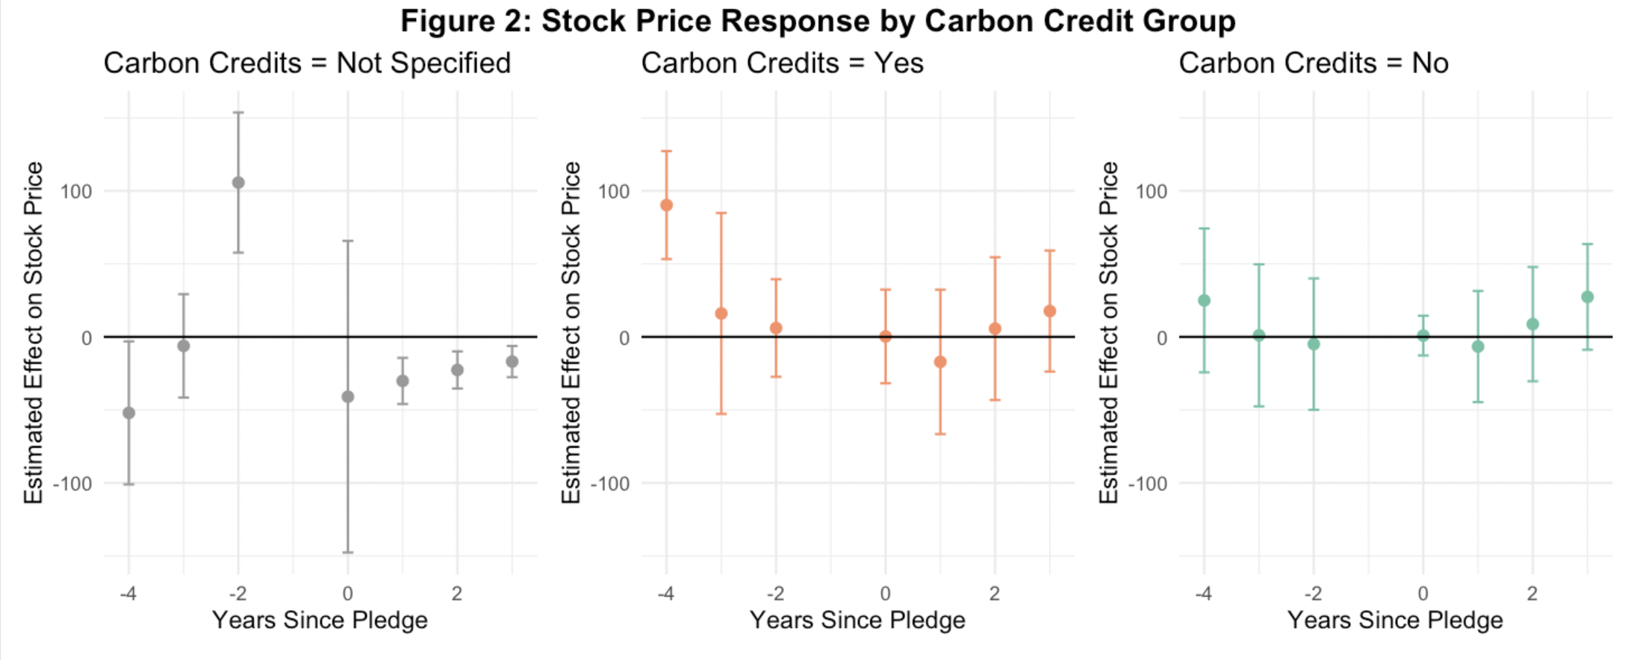
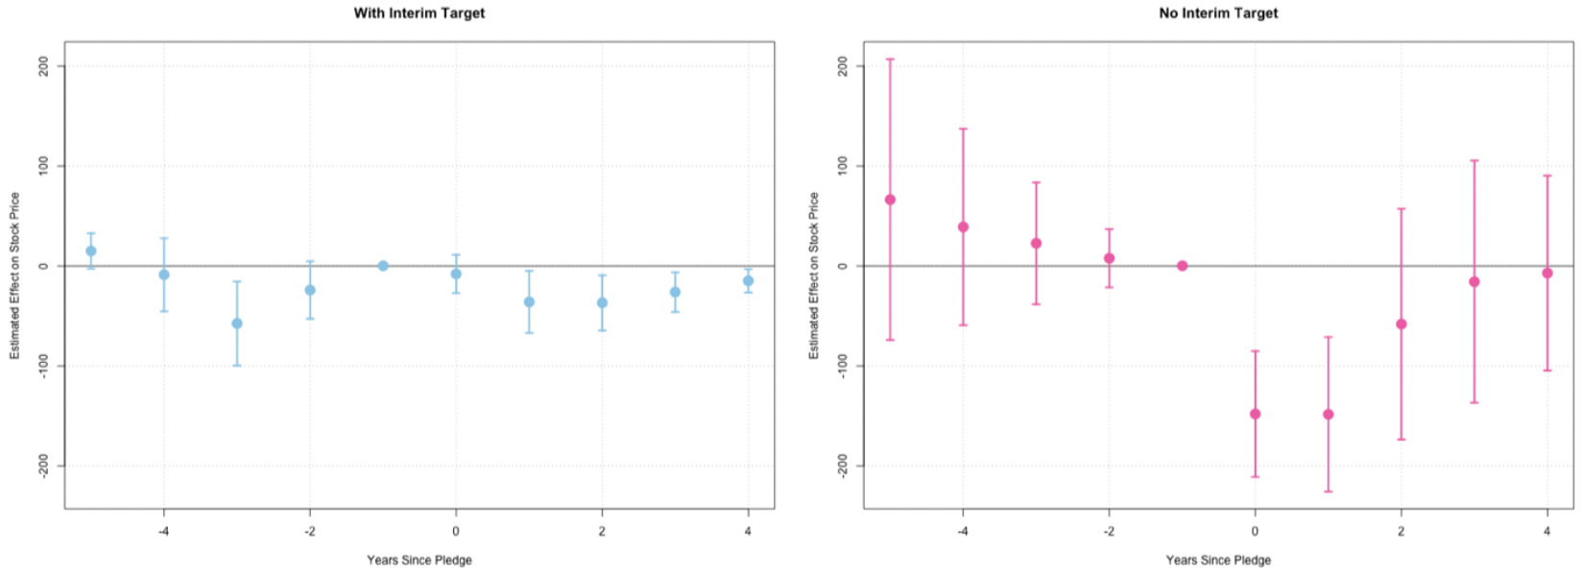
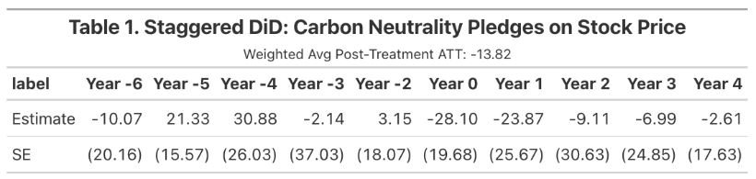
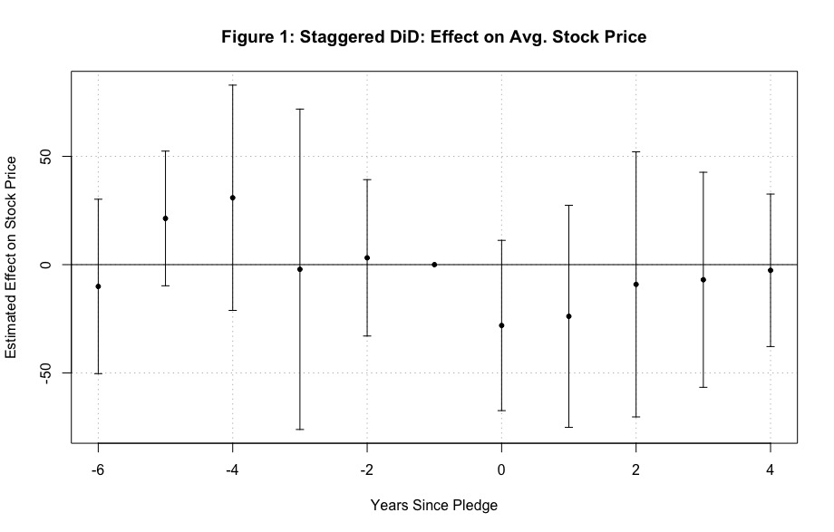
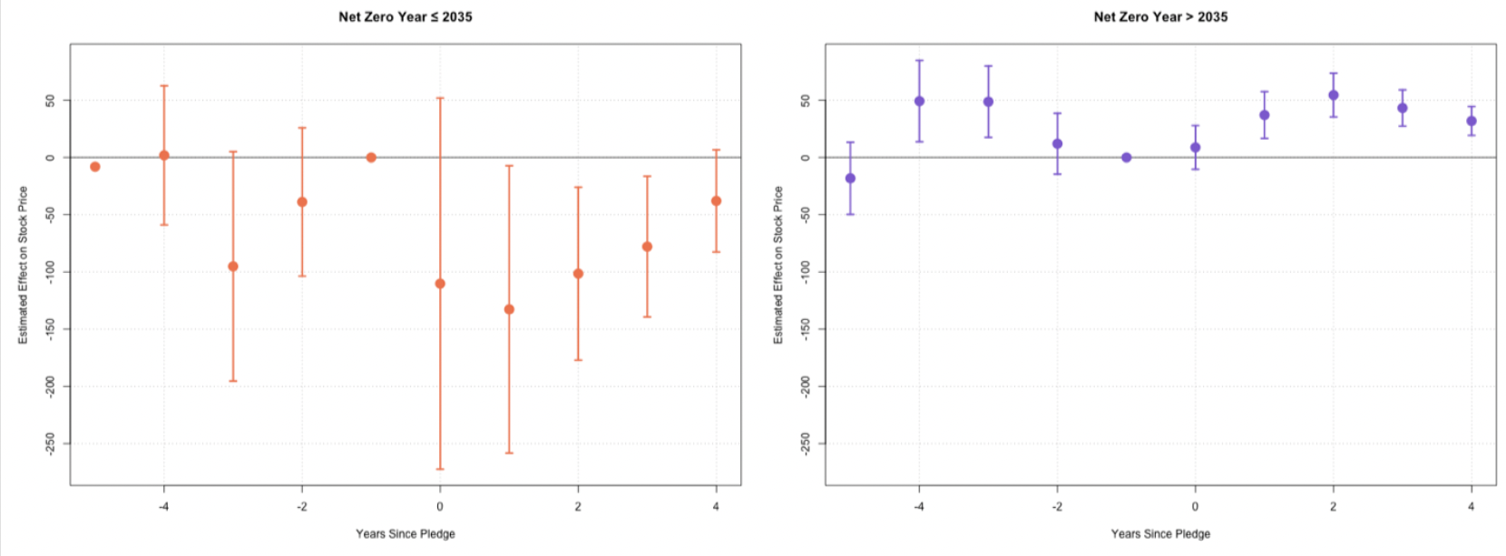
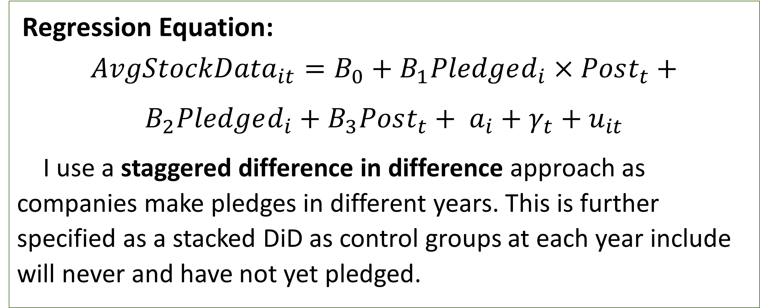
Market Reactions to Corporate Carbon Neutral Pledges: A Staggered Difference-in-Differences Approach with Heterogeneity Analysis
Elijah Toffel, Bates College
Introduction and Context
Methods
Heterogeneity
Modern Company Goals:
Consumer decisions often go beyond the product itself, as company identity has become increasingly tied to the goods and services they offer.
Sustainability has become a key factor in companies earning or losing social credit.
The Climate Commitment Landscape:
In 2015, the Paris Agreement called for:
  A global effort to limit warming to 1.5–2°C above pre-industrial levels.
  Rapid reductions in greenhouse gas emissions.
In response, many companies have pledged to reach carbon neutrality, often with target dates and varying levels of detail.
What This Study Explores:
How does the stock market react to carbon-neutral pledges?
Do different types of pledges—like those with clear goals or more urgency to complete—affect market valuation differently?
Regression Equation:
$${AvgStockData}_{it}={B_{0}+B}_{1}Pledged_{i}×Post_{t}+$$
$$B_{2}Pledged_{i}+B_{3}Post_{t}+ a_{i}+γ_{t}+u_{it}$$
I use a staggered difference in difference approach as companies make pledges in different years. This is further specified as a stacked DiD as control groups at each year include will never and have not yet pledged.
Figure 2: Stock Price Response by Carbon Credit Group
Figure 3: Stock Price Response by Interim Target
Figure 4: Stock Price Response by Complete-by Date
Main Results
Figure 1 and Table 1 shows that companies’ stock prices that make carbon pledges dramatically drop from in their first year and steadily recover over the following years.
Related Literature
Varying Stock Market Analysis:
Short Term: “Overall, this downward trend of cumulative average abnormal returns generally reflects that the market shows negative attitudes towards such carbon zero pledges, therefore causing losses in firms’ market value in the short run” (Xie et al).
Long Term: “Our event-study evidence shows a positive impact of green pledges on stock market valuations that is statistically and economically significant. Investors appear to view the anticipated benefits of green pledges as outweighing the costs, and the market response may provide additional financial incentives for decarbonization” (Bauer et al).
Future Work and Acknowledgements
Data
Discussion
For future work, I would like to expand the sample size and use a matching setup to create the strongest counterfactual comparison as possible. I would also like to expand my analysis to media attention (news articles) and reputation effects with the larger sample size.
I would like to acknowledge the continued help of my thesis advisor, Professor Coombs, and the rest of my Economics Seminar in providing feedback and guidance throughout this process.
I use three sources of data:
To determine a sample, I use Harris Poll Data from 2019-2024 on the 100 most visible companies each year, based on a random sample. I restrict the sample to public companies that appear on more that one year’s list.
Stock data for public companies is from Macrotrends.
Carbon Neutral Tracker variables on pledge characteristics, alongside scraped data on pledge dates and complete-by dates. I combine net-zero and carbon neutral as treatment.
While I initially hypothesized that carbon-neutral announcements would boost share prices, the data suggests concerns over financial efficiency leads to price drops. Figures 2 and 3 show that investors respond negatively to vague commitments like “Not Specified” and “No Interim Targets.” Figure 4 reveals that the farther the target completion date, the less negative the market reaction. These results indicate that market reactions reflect investor concerns about potential disruptions from process overhauls.
Citations:
Bauer, Michael, Daniel Huber, Eric Offner, Marlene Renkel, and Ole Wilms. Corporate Green Pledges. December 2, 2024. https://www.michaeldbauer.com/files/green_pledges.pdf
ChatGPT. "I Pledge to Reduce Carbon" badge. AI-generated image. OpenAI, 2025.
Xie, Xinyi, Jianan Lu, Mao Li, and Jiang Dai. 2023. “Does Carbon Neutrality Commitment Enhance Firm Value?” Journal of Chinese Economic and Business Studies 21 (1): 49–83. doi:10.1080/14765284.2022.2161171.

